Slide 1
Lecture #1: Introduction to CS109A aka STAT121A, AC209A, CSCIE-109A

Slide 2
Lecture Outline
Why data science? Why taking CS109A?
What is data science?
What is this class and what it is not?
The data science process
Example

Slide 3
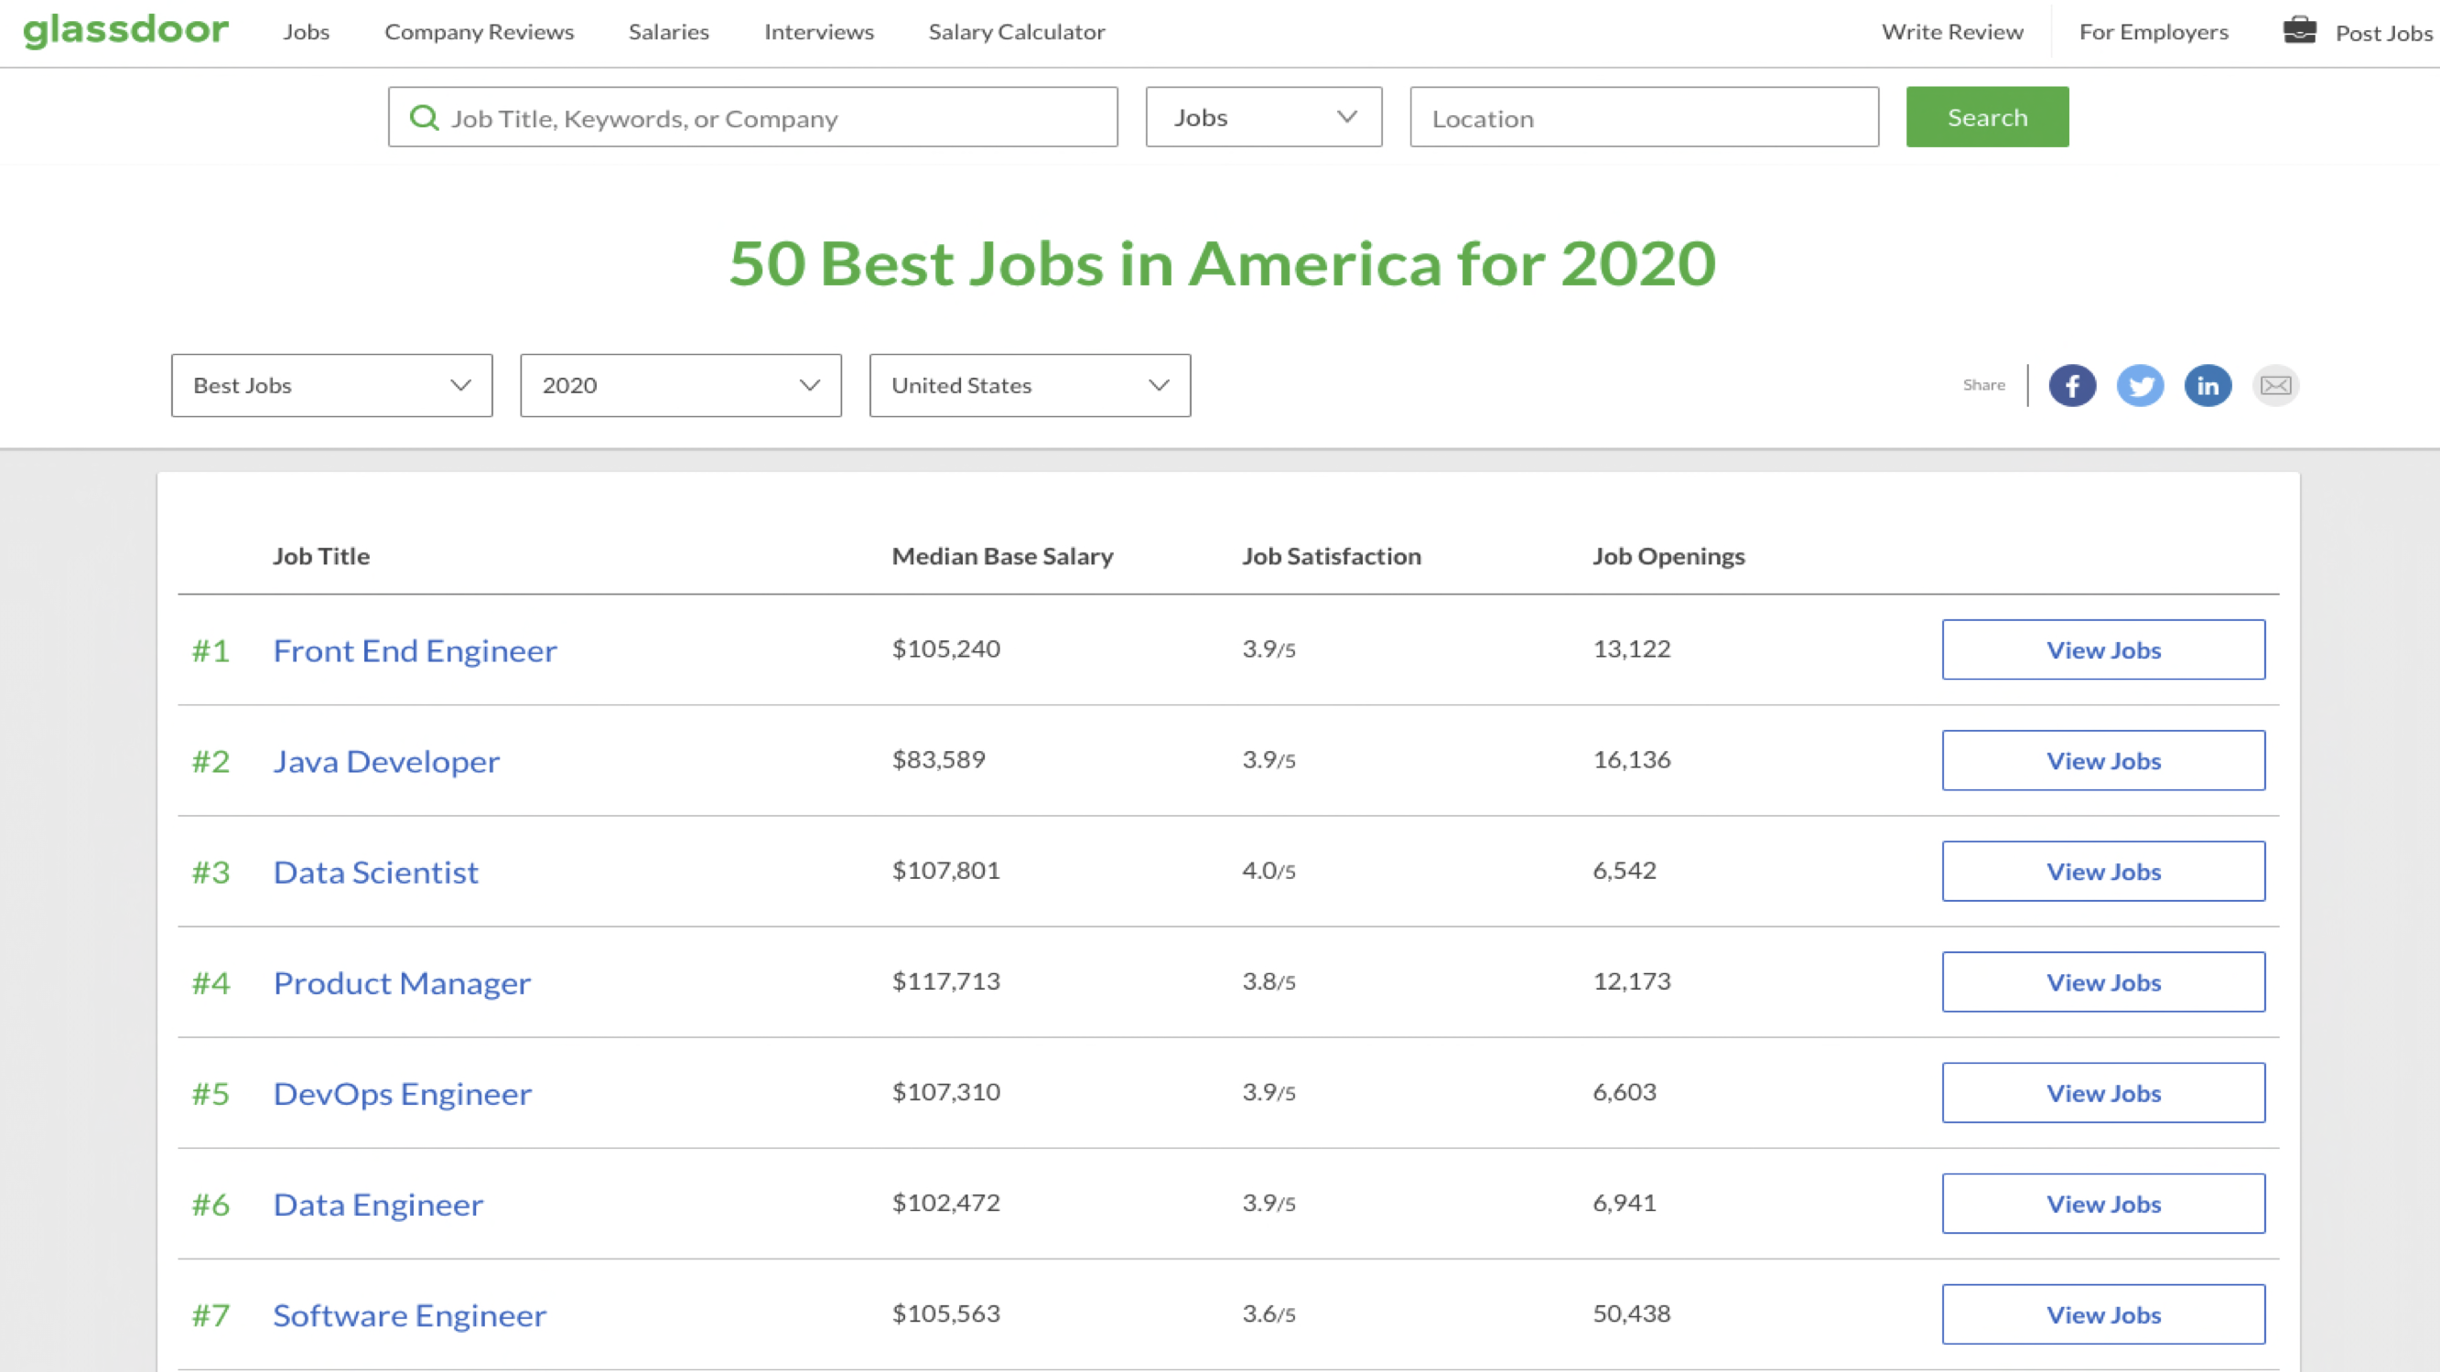
Why?
Jobs!

Slide 4
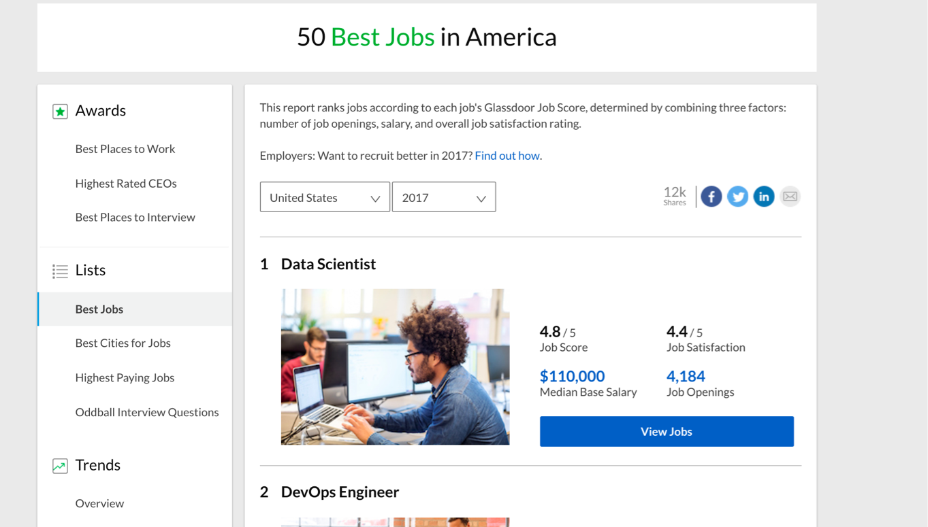
Why?
Jobs!

Slide 5
Why?
Why do I love data science?
Why are you here?

Slide 6
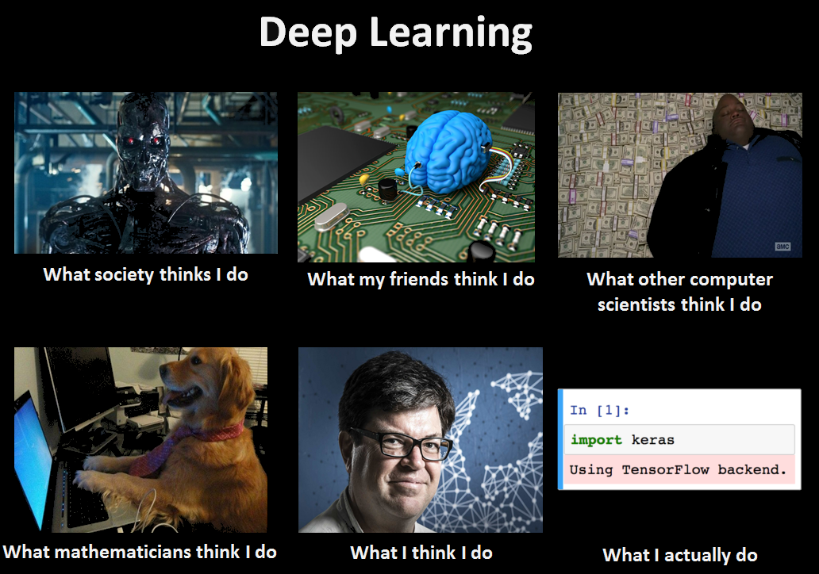
Memes !

Slide 7
Why?
Why are you here?

Slide 8
What is data science?

Slide 9
A little bit of history

Slide 10
History
Long time ago (thousands of years) science was only
empirical and people counted stars

Slide 11
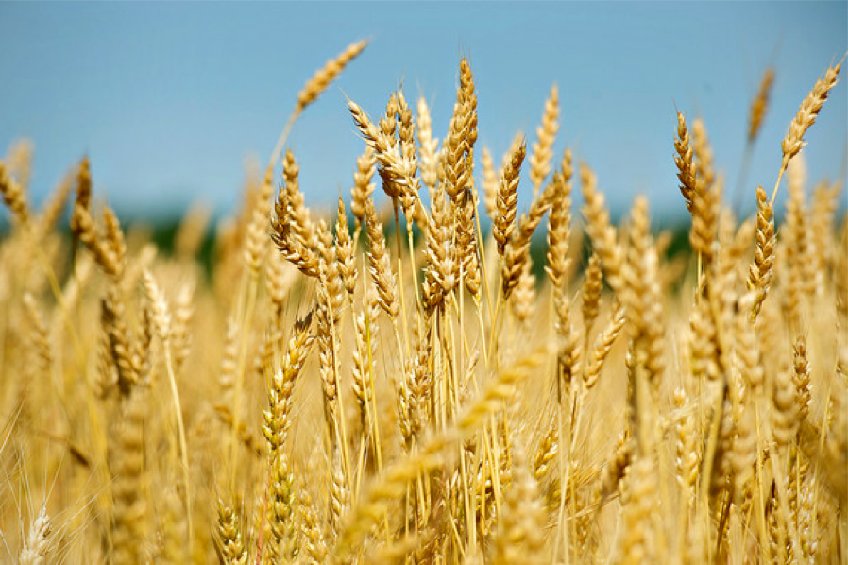
History (cont)
Long time ago (thousands of years) science was only
empirical and people counted stars or crops

Slide 12
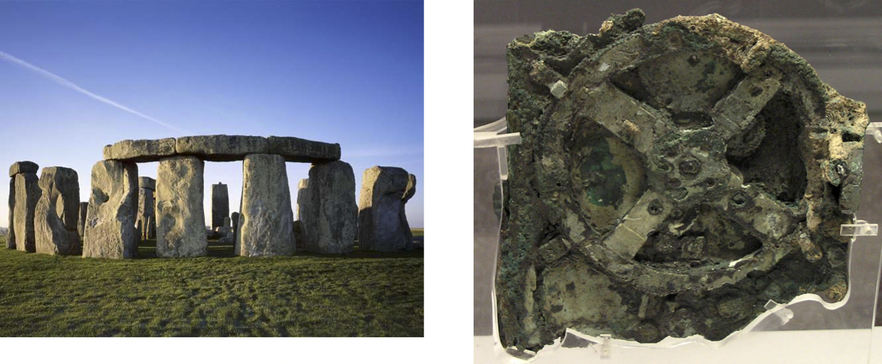
History (cont)
Long time ago (thousands of years) science was only
empirical and people counted stars or crops and used the data to create machines to describe the phenomena
Notes:
Stonehedge: 3000 BC to 2000 BC. astronomical significance of the site for its people, are a matter of speculation and debate.
Antikithira mechanism 150 and 100 BC It is a complex clockwork mechanism composed of at least 30 meshing bronze gears.

Slide 13
History (cont)
Few hundred years: theoretical approaches, try to derive
equations to describe general phenomena.

Slide 14


History (cont)
About a hundred years ago: computational approaches
Notes:
Eniac

Slide 15
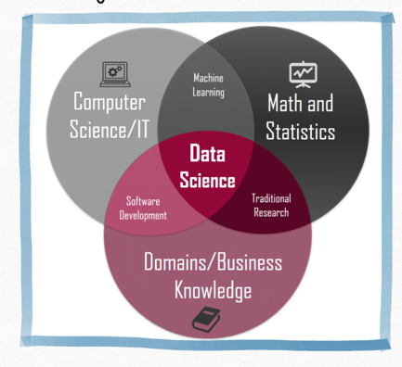
History (cont)
And then …. data science
In both data science and machine learning we extract pattern and insights from data.
Inter-disciplinary
Data and task focused
Resource aware
Adaptable to changes in the environment and needs
Notes:
Eniac

Slide 16
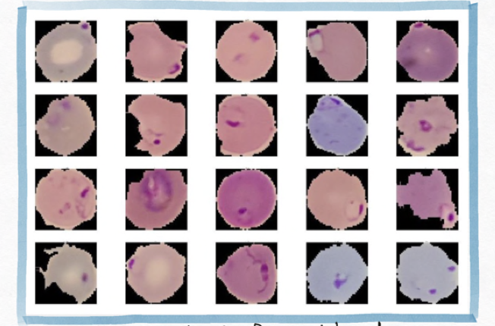
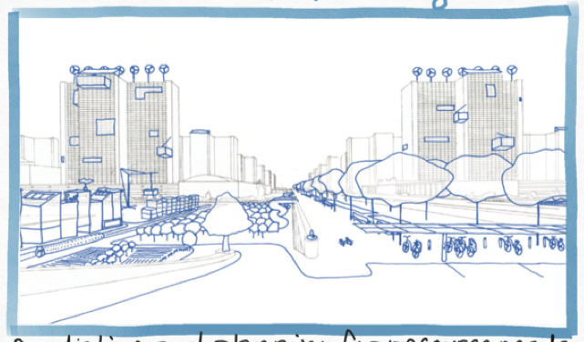
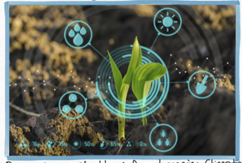

The Potential of Data Science
Disease Diagnosis
Urban Planning
Detecting malaria from blood smears
Predicting and planning for resource needs
Agriculture
Drug Discovery
Quickly discovering new drugs for COVID
Precision agriculture

Slide 17



The Potential of Data Science
Gender Bias
Racial Bias
Some DS models for evaluate job applications show bias in favor of male candidate
Risk models used in US courts have shown to be biased against non-white defendants

Slide 18
What?
The Data Science Process
Ask an interesting question
Get the Data
Explore the Data
Model the Data
Communicate/Visualize the Results

Slide 19
What?
The Data Science Process
Ask an interesting question
What is the scientific goal?
What would you do if you had all of the data?
What do you want to predict or estimate?
Get the Data
Explore the Data
Model the Data
Communicate/Visualize the Results

Slide 20
What?
The Data Science Process
Ask an interesting question
How were the data sampled?
Which data are relevant?
Are there privacy issues?
Get the Data
Explore the Data
Model the Data
Communicate/Visualize the Results

Slide 21
What?
The Data Science Process
Ask an interesting question
Plot the data.
Are there anomalies or egregious issues?
Are there patterns?
Get the Data
Explore the Data
Model the Data
Communicate/Visualize the Results

Slide 22
What?
The Data Science Process
Ask an interesting question
Build a model.
Fit the model.
Validate the model.
Get the Data
Explore the Data
Model the Data
Communicate/Visualize the Results

Slide 23
What?
The Data Science Process
Ask an interesting question
What did we learn?
Do the results make sense?
Can we effectively tell a story?
Get the Data
Explore the Data
Model the Data
Communicate/Visualize the Results

Slide 24
What?
The material of the course will integrate the five key facets of an investigation using data:
data collection; data wrangling, cleaning, and sampling to get a suitable data set.
data management; accessing data quickly and reliably.
exploratory data analysis; generating hypotheses and building intuition.
prediction or statistical learning.
communication; summarizing results through visualization, stories, and interpretable summaries.

Slide 25
Goal of the course
Theory
Practice
Impact
Key Machine Learning concept
Important metrics for evaluation
Handling different kinds of data
Extracting insights from analysis of the models
Implement ML and deep learning models using python libraries
Using free online tools and resources for data science
Solving real-life problems using DS
Evaluating the social impact of DS

Slide 26
Weeks 8: Data
Weeks 1-2: Data
Data Imputation
PCA
Data Formats + Web Scraping
Pandas
Weeks 9-10: Trees
Weeks 3-5: Regression
Decision Trees
Bagging Random Forest Boosting Methods
kNN Regression
Linear Regression
Multi and Poly Regression
Model Selection and Cross Validations
Inference
Bootstrap
Ridge and Lasso Regularization
Weeks 11-12: Neural Networks
Multi-Layer Perceptron
Architecture of NN
Fitting NN, backprop and SGD
Regularization of NN
Weeks 6-7: Classification
Weeks 13-14
kNN Classification
Logistic Regression
Multi-class Classification
Ethics
Model Interpretation

Slide 27
CS109B
After CS109A
AC295
A. Neural Networks:
CNNs
RNNs
Generative models
B. Unsupervised Clustering
C. Piecewise Linear Regression
D. Bayesian Modeling
A. Productions Data Science, from notebooks to the cloud
B. Big models, transfer learning and architecture learning
C. Visualization tools for interpreting models

Slide 28
Not an exclusive list
CS171 (Visualization)
CS182 (AI)
CS181 (ML)
CS 187 (NLP)
Stat 110 (Probability)
Stat 111 (Inference)
Stat 139 (Linear Models)
Stat 149 (generalized linear models)
Stat 131 (Time Series)
Stat 171 (Stochastic Processes)
Stat 195 (Statistical Machine Learning).

Slide 29
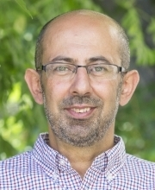

Who? Instructors
Pavlos Protopapas
Scientific director Institute of Applied Computational Science
Kevin Rader
Senior preceptor in Statistics
Chris Tanner
Lecturer at Institute of Applied Computational Science

Slide 30
Who?
Eleni Kaxiras
Supportive Instructor
Assistant Director for Data Science and Computation at SEAS
Marios Mattheakis
Section Leader
Post-doctoral Fellow IACS
Chris Gumb
Head TF
Graduate student of Data Science at Harvard Extension School

Slide 31
Who? Teaching Fellows

Slide 32
Course Components

Slide 33
Lectures, Advanced Sections, Sections and Office Hours
During lecture will cover the material which you will need to complete the homework, and to survive the rest of your life in CS109A.
We will use a mix of notes and exercises via edstem.
Lecture notes and associated notebooks will be posted before lecture on GitHub and on edstem.
Lectures will be video taped (and live streamed) and posted approximately within 24 hours on web page.
We will have two ‘shows’ , morning and matinee (A, B)
A: Morning Mon/Wed/Fri 9:00-10:15am @Zoom
B: Matinee Mon/Wed/Fri 3:00-4:15pm @Zoom

Slide 34
Lecture format
Quiz
Finish exercises from previous lecture
Reading or Video Watching for next lecture
ASYNCHRONOUS
Questions from asynchronous material, review of quiz and homework
Live Lecture
SYNCHRONOUS
Q&A
The “hands-on exercises” part will be longer during the Friday lecture as opposed to Mon/Wed.
Hands-on exercises in breakout rooms
Discussion about the exercises
Repeat
…
Summary and conclusions
34

Slide 35
Advanced Sections, Sections and Office Hours
Lectures are supplemented by 1.25 hours sections led by teaching fellows.
There are two types of sections:
Standard Sections will be a mix of review of material and practice problems similar to the homework.
Friday 1:30-2:45 pm, and Mon 8:30-9:45 pm @zoom
Advanced Sections (A-Sections) will cover advanced topics like the mathematical underpinnings of the methods seen in lectures and labs.
Weds 12:01 pm - 1:15 pm @zoom. A-sections are required for AC209 students.
Note: Sections are not held every week. Consult the course calendar for exact dates.

Slide 36
Advanced Sections topics
Topics
Linear Algebra and Hypothesis Testing: The Short Versions
Methods of regularization and their justifications
Generalized Linear Models
Mathematics of PCA
Ensemble methods
Stochastic Gradient Descent and solvers
NOTE 1: The materials in the Advanced Sections are required for all AC 209A students. There will be one extra question in most homework for AC 209 students which will be based on the A-Section materials.
NOTE 2: No additional quizzes for A-section.
NOTE 3: A-sections and Friday’s regular section will be live streamed to everyone.

Slide 37
Office Hours

Slide 38
Assignments

Slide 39

Four Graded Components
Homework: 63%
Exercises: 6%
Quizzes: 6%
Homework zero: 1%
Individual Homework (2): 10%
Paired Homework (6): 42%
HW4 and HW6 are the indiv. HW
During lecture.
All questions are weighted equally.
Due at the beginning of the next morning lecture.
End of each lecture.
25% of the quizzes will be dropped from your grade.
All questions are weighted equally.
Due at the beginning of the next morning lecture.
Projects: 25%
Three milestones plus final presentation and a report in the form of a blog. More details soon.

Slide 40
Homework(s)
There will be 8 homework (not including Homework 0):
Homework 0 (due Sept 9)
Homework 1: Web scraping, Beautiful Soup
Homework 2: Regression kNN and LinReg
Homework 3: Multi-regression, polynomial reg and model selection
Homework 4*: Log Reg
Homework 5: PCA and ethics
Homework 6: Random Forest, Boosting and Neural Networks
Homework 7*: Neural Networks
Homework 8: Ethics and model interpetation

Slide 41
Homework(s)
You are encouraged but not required to submit in pairs, except homework 4 and homework 7, which you must work individually.
We will be using the Groups function in Canvas to do this, details to be announced later.
All homework are due 11:59 pm Wednesdays, and homework will be released on Wednesdays.

Slide 42
Final Project
There will be a final group project (2-4 students) due during exams period.
We will provide 7 pre-defined projects which you could use for your final project.
In some very special cases you can use your own (public) data set and your own project definition (to be approved by the instructors)
Project topics will be announced September 10th.

Slide 43
Help
The process to get help is:
Post the question in Ed, and hopefully, your peers will answer. We monitor the posts, and we will respond within 8 hours from the posting time.
Attend the Office Hours; this is the best way to get help.
For private matters, send an email to the Helpline: cs109a2020@gmail.com. All the instructors and TFs monitor the Helpline.
For personal matters, send an email to Pavlos, Kevin, and Chris.
Sundays will be slow days, so please be patient!

Slide 44
Tools for the course
Web page
edstem
Canvas
Syllabus
Calendar
Link to materials
Forum
Quizzes
Reading assignments
Hands on exercises
Links to lectures
Homework
Grades

Slide 45
Misc
Video release form: https://canvas.harvard.edu/courses/74056/quizzes/182045
Backup plan if zoom dies:
We will do lecture the next lecture (A or B). If it’s still not up by then, we will record and upload to canvas.
Forming groups:
https://docs.google.com/forms/d/e/1FAIpQLSfIsQyxdCwUCbJmyWyotp30anrKsuGHfIHt-DQEKMnK8iE4TA/viewform
Study breaks: Thurs 9/10 @8:30pm & Fri 9/11 @10:15am

Slide 46
Breakout rooms and in-class exercises
Some students are having issues with Safari.

Slide 47
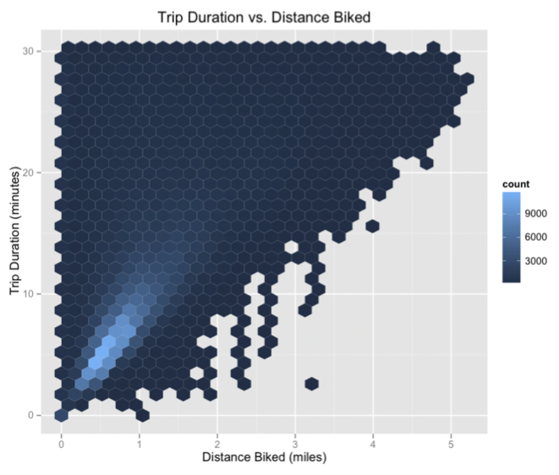
Inspirations for Data Viz/Exploration
So how well did we do in formulating creative hypotheses and manipulating the data for answers?
Check out the winners of the Hubway Challenge:
http://hubwaydatachallenge.org

Slide 48

Statistics. Math. Computer Science. Physics. Long ago, the four disciplines lived together in harmony. Then, everything changed when the Computer Science attacked. Only a master of all four elements, could stop them, but when the world needed it most, it was not invented. A few years ago the world discovered the new master, a scientist called data scientist, a master of all four elements

